Slide 1
Balance Health, Work & Life
(Bharath)

Slide 2
Objective
Get it all done attitude at office or at home, causing our stress levels spike and productivity plummets. Stress can zap our concentration, make us irritable or depressed, which in turn might lead to fatal issues like CHDs.
Provide a solution that can monitor and provide recommendations/alert the users about their health.
Reduce the percentage of people loosing their lives due to CVDs.

Slide 3
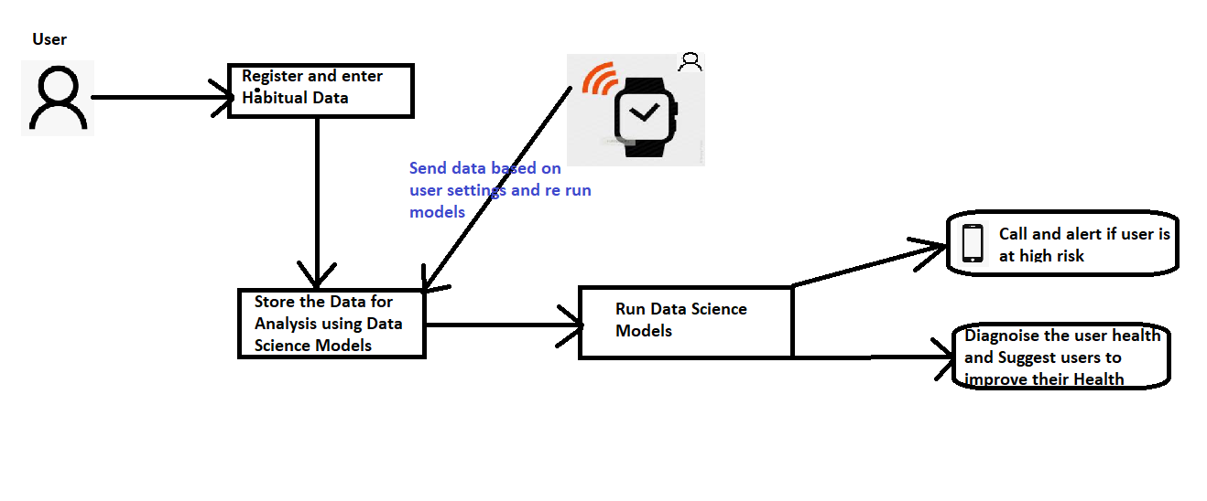
Flow Chart of Application

Slide 4
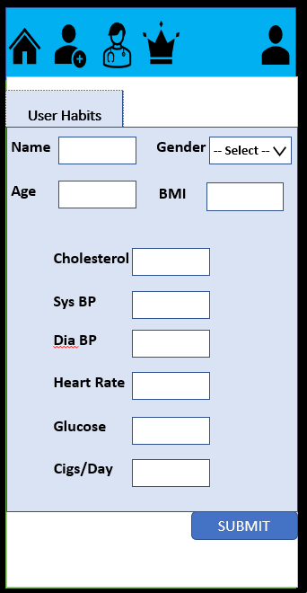
Habitual Data Collection
User need to enter their Habitual Data which will be used by the Data Science models for Diagnosing their health.

Slide 5
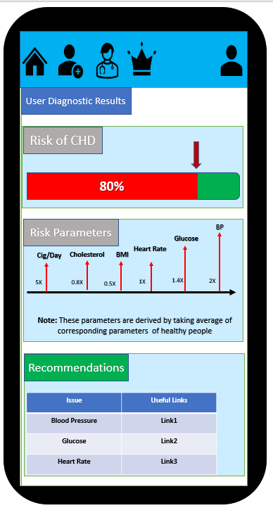
Habitual Data Collection
After running the Diagnostics on user data, following tasks are done.
Call and alert if user is at High risk of Cardiovascular Disease (CVD).
Show users overall Risk to CVD.
Show users on parameters that are putting them at risk towards CVD.
Recommend Possible solutions to their high risk parameters.

Slide 6
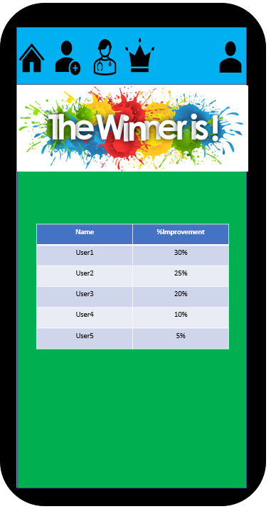
Build Competition
Build competition among users to stay healthy.
Show list of top users who are getting healthy.

Slide 7
Conclusion
This solution helps them in 3 main aspects:
Perform predictive Analysis on their health based on provided data.
Monitor users’ health all the time.
Alert and prevent any casualties on time.

Slide 8
Demo
Open Protype_Demo_App.pptx.
Click on the Header Icons to Navigate to UI Prototype of each page.

Slide 9
Q&A

